Slide 1
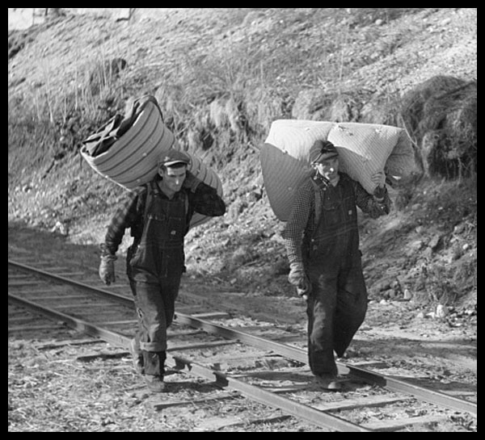
At The Fab Lab Three Lakes

Slide 2
MDC 30’ Overton Car Interiors for 3D Printing

Slide 3
Ready on the MakerBot Printer

Slide 4
MakerBot 30’ Overton Interior

Slide 5
MakerBot 30’ Overton Interiors

Slide 6
Ore Car Frames for 3D Printing

Slide 7
Original Cast Metal Frame

Slide 8
Mold of Original Failed

Slide 9
First 3D Print on the MakerBot Failed

Slide 10
New 3D Drawing

Slide 11
uPrint Ore Car Frame Functional

Slide 12
Redesigned for MakerBot

Slide 13
Redesigned MakerBot Frame Functional

Slide 14
MakerBot and uPrint Frames

Slide 15
Design Process at the Fab Lab

Slide 16
Start to Finish Ore Car 3D Frames

Slide 17
Freight Car Frames Designed for 3D Printing

Slide 18
3D Prints from the uPrint

Slide 19
PLA Frame just off the support material

Slide 20
Logging Caboose

Slide 21
Interior Walls Cut by Laser

Slide 22
Parts of the Car Ready to Paint

Slide 23
Logging Caboose Drafting

Slide 24
New Laser Cut Caboose Bodies

Slide 25
3D Printed Doors on the Laser Cut Car

Slide 26
Testing the fit of Walls

Slide 27
Laser Cut Caboose Walls

Slide 28
Inside and Outside Laser Cut Walls

Slide 29
Rear Wall Inside

Slide 30
Assembly of Walls

Slide 31
Outside Bracing in AI to Cut Failed

Slide 32
Outside Bracing for Caboose to Print Worked!

Slide 33
Under Frames with Details

Slide 34
Pickle Tub Car Drawing

Slide 35
Pickle Tub Car Parts Layout for Laser

Slide 36
Pickle Tub Car Parts Layout in AI

Slide 37
Pickle Tub Car Parts

Slide 38
Steel Under Frames for 3D Printing

Slide 39
3D Parts Check

Slide 40
Coffin Style Pickle Car

Slide 41
50’ Overton Passenger Car Interiors

Slide 42
Loading into the uPrint Printer

Slide 43
First Printed Interior

Slide 44
Interior In the Overton Car

Slide 45
Modern Passenger Car End Drawing

Slide 46
Modern Passenger Car End Ready to 3D Print

Slide 47
First uPrint Car End

Slide 48
Original Car End

Slide 49
Original, uPrint, And MakerBot

Slide 50
Control Panels to Cut in AI

Slide 51
Winter Project

Slide 52
3D Model

Slide 53
HO Winter Project on AI

Slide 54
Inside on AI Ready to Cut

Slide 55
Winter Project Laser Cut Kit

Slide 56
Additional Parts Laser Cut

Slide 57
Roof Parts Cut from Plastic

Slide 58
Paper Printed Structure

Slide 59
Paper Printing Design

Slide 60
3D stl File for Printing

Slide 61
3 Kits in HO Scale, Laser Cut

Slide 62
Digital Command Control Panel

Slide 63
Digital Command Control Panel

Slide 64
Digital Command Control Panel

Slide 65
Woodboro Warehouse

Slide 66
Gathering Data

Slide 67
Warehouse Design

Slide 68
Warehouse Design

Slide 69
Prototype

Slide 70
Model

Slide 71
Community Support

Slide 72
3D Farm House

Slide 73
Drawing in 3D .stl

Slide 74
Print Ready Copy

Slide 75
Laser Printing on A Mirror

Slide 76
Finished Print

Slide 77
Carole Printing on the Laser

Slide 78
Drafting for Carl’s Artwork

Slide 79
Carl Wood Craft Art on AI

Slide 80
Carl’s Laser cut Model

Slide 81
An Image for Jack to Etch

Slide 82
Image Ready to Etch on the back of a Mirror

Slide 83
Final Image

Slide 85
Paul’s PL&S RR

Slide 86
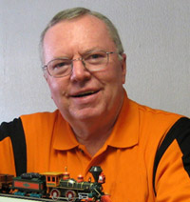
Thanks for Watching TLMRC.ORG

